Slide 1
EDA Report for Telecom Customers Churn Analysis

Slide 2
Business Understanding & Overview
You have to use EDA to analyse the customers who are churned.
We will perform this Exploratory Data Analysis in order to get actionable insights, and convert them into meaningful stories and present it so that the companies can take necessary actions in order to retain their customers.

Slide 3
Understanding the data

Slide 4
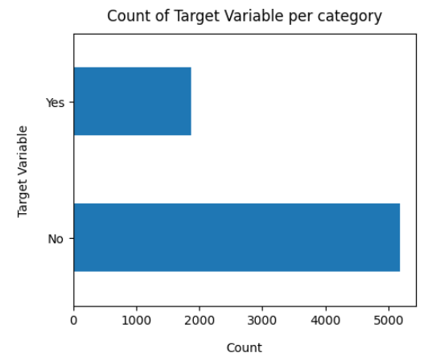
Target Variable
Findings
Data is highly imbalanced, ratio is almost 74:26.
Most of the customers are not churn. (Tagert: No)
We need to analyse the data with other features while taking the target values separately to get some insights.

Slide 5
Missing Data - Initial Intution
Findings
Here, we don't have any missing data.
General Thumb Rules:
For feature with less missing values - can use regression to predict the missing value or fill with mean/median/mode of the value present, depending on the feature.
For feature with very high number of missing values - it is better to drop those columns as they give very less insights on analysis.
As there's no thumb rule on what criteria do we delete the columns with high number of missing values, but generally you can delete the columns, if you have more than 30-40% of missing values. But again there's a catch here, for example, is_car & car_type, People having no cars, will obviously have car_type as NaN (null), but that doesn't make this column useless, so decision has to be taken wisely.

Slide 6
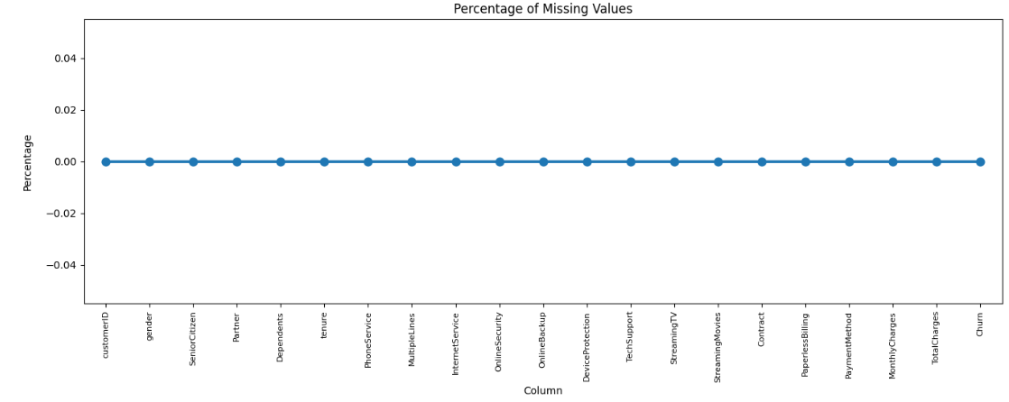

Slide 7
TotalCharges should be numeric amount.
After conversion, there are 11 missing values in TotalCharges column.
Since the % of these records compared to the total dataset is very low i.e 0.15%, it is safe to ignore them from further processing.

Slide 8
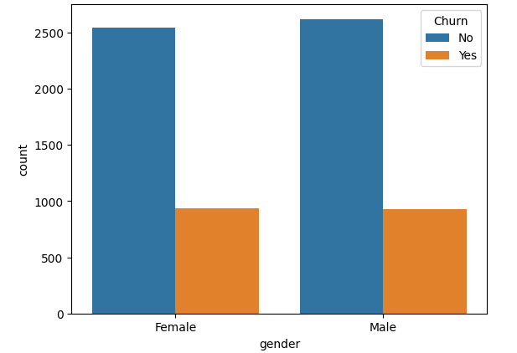
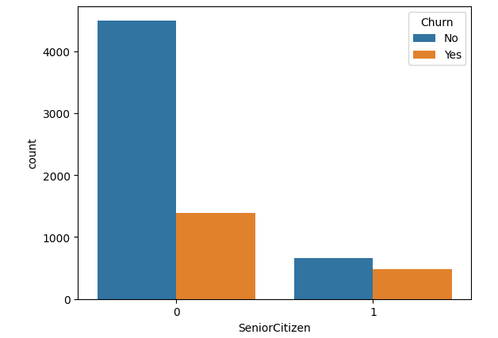
Univariate Analysis
Findings
Gender : Churn rates are evenly split between males (26%) and female (26%) customers, indicating gender alone does not significantly influence churn behaviour
SeniorCitizen: Non-senior citizens (58.31% churn) have a higher churn rate compared to senior (23.60% churn).

Slide 9
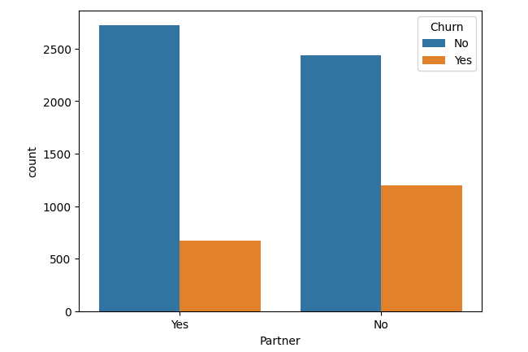
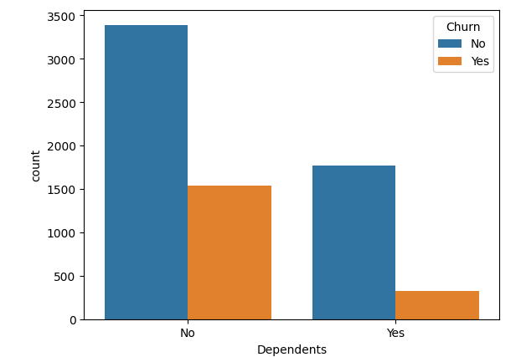
Findings
Partner and Dependents: Customers without a partner (32.93% churn) or dependents (31.27% churn) churn more compared to those with a partner (19.66% churn) or dependents (15.45% churn).

Slide 10
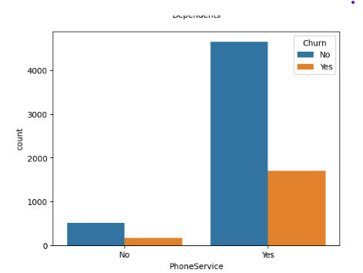
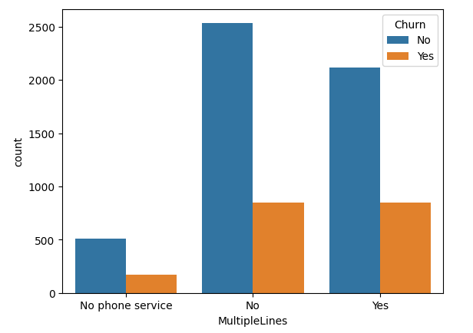
PhoneService: Churn rates are similar for customers with (26.70%) or without (24.92%) phone service, indicating minimal impact on churn.
MultipleLines: Customers with multiple lines (28.60% churn) have a slightly higher churn rate than those with single lines (25.04% churn).

Slide 11
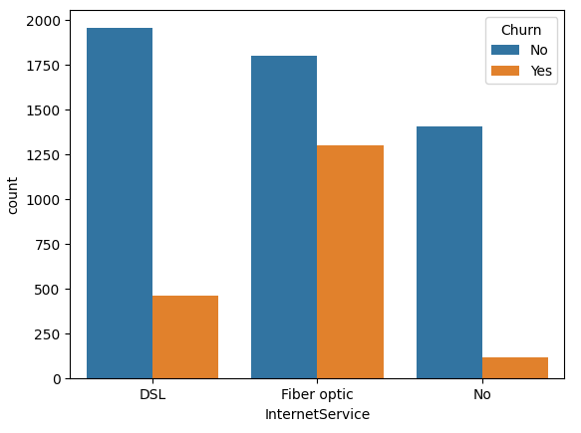
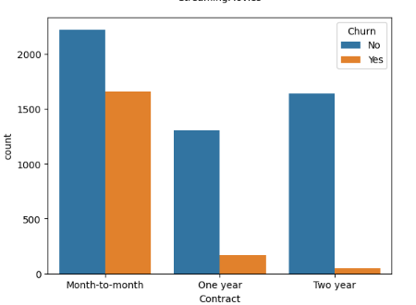
InternetService: Fibre optic users (41.89% churn) have higher churn rates than DSL users (18.95% churn).
Contract Type: Month-to-month contracts (42.70% churn) have higher churn rates compared to one-year (11.26%) or two-year contracts (2.83%).

Slide 12
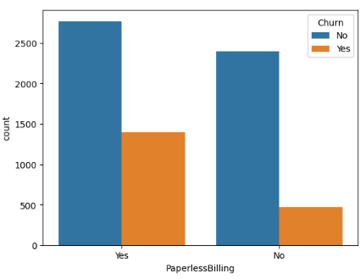
PaperLessBilling: Customers with paperless bills (33.56% churn) have higher churn rates than those with paper bills (16.33%).

Slide 13
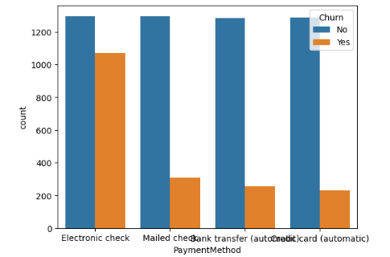
PaymentMethod: Customers using electronic checks (45.28% churn) have higher churn rates compared to mailed checks (19.10%), bank transfers (16.70%), or credit cards (15.24%).

Slide 14
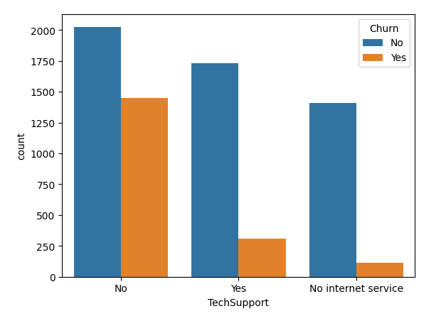
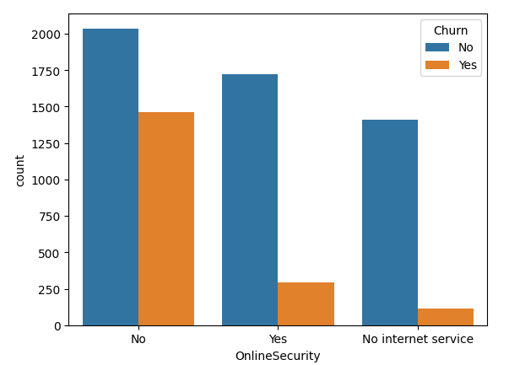
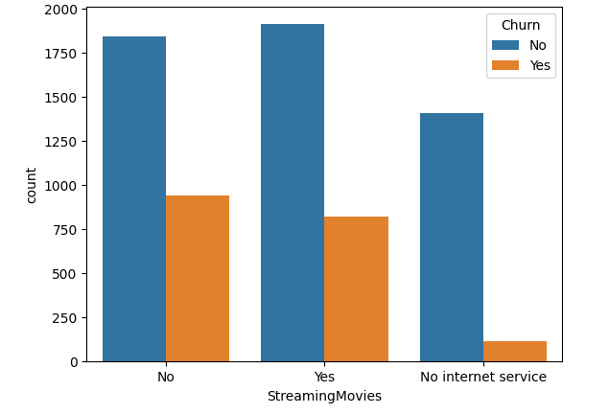
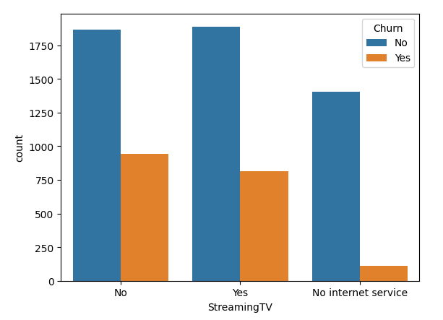
Additional Services: Customers without additional services like online security, tech support, or streaming options tend to churn more.

Slide 15
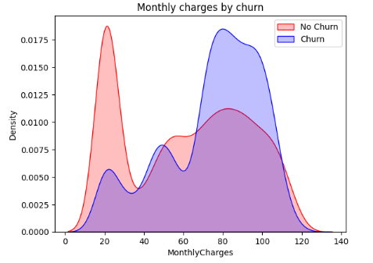
Numerical Analysis
Insights: Churn is high when Monthly Charges are high.

Slide 16
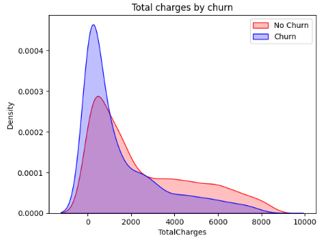
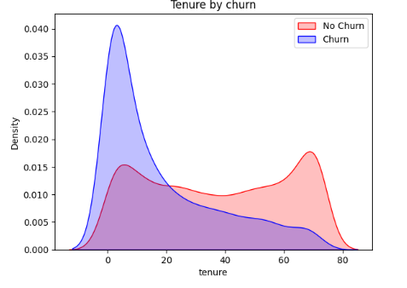

Slide 17
Surprising insight as higher Churn at Total Charges
However if we combine the insights of 3 parameters i.e Tenure, Monthly Charges & Total Charges then the picture is bit clear: Higher Monthly Charge at lower tenure results into lower Total Charge. Hence, all these 3 factors viz Higher Monthly Charge, Low tenure and Lower Total Charge are linked to High Churn.

Slide 18
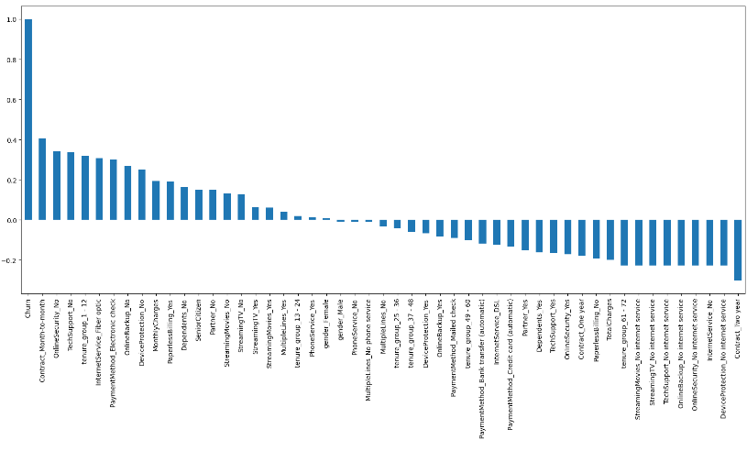

Slide 19
Derived Insight:
High Churn is seen in case of Month to month contracts, No Tech support, First year of subscription, Payment via Electronic Check and Fibre Optics Internet.
Low Churn is seen in case of Long term contracts, Subscription without Internet service and The customers engaged for 5+ years.
Factors like Gender, Availability of PhoneService and number of Multiple lines have almost No impact on Churn.

Slide 20
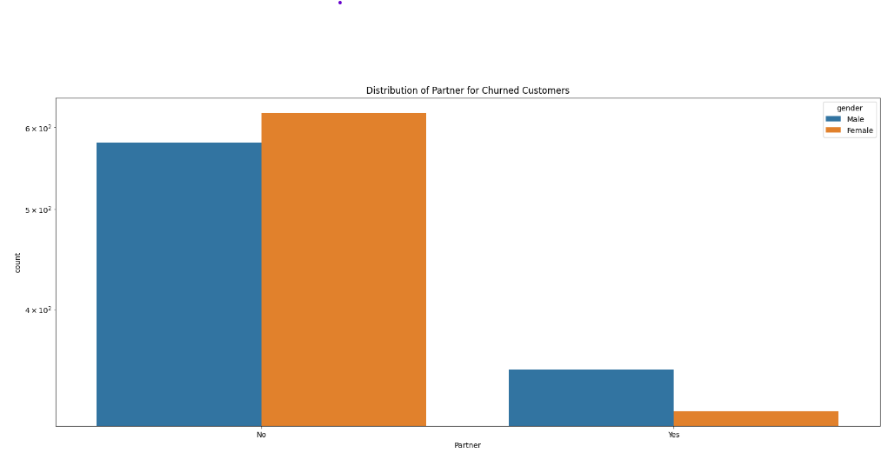
Bivariate Analysis

Slide 21
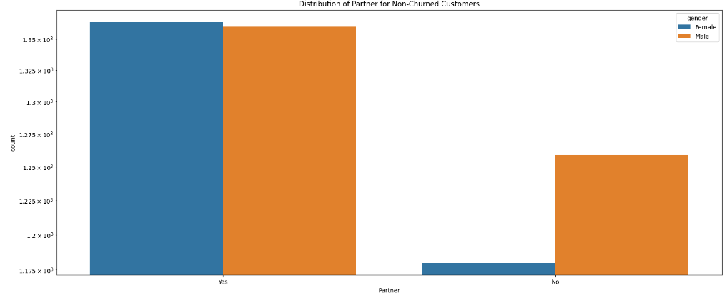

Slide 22
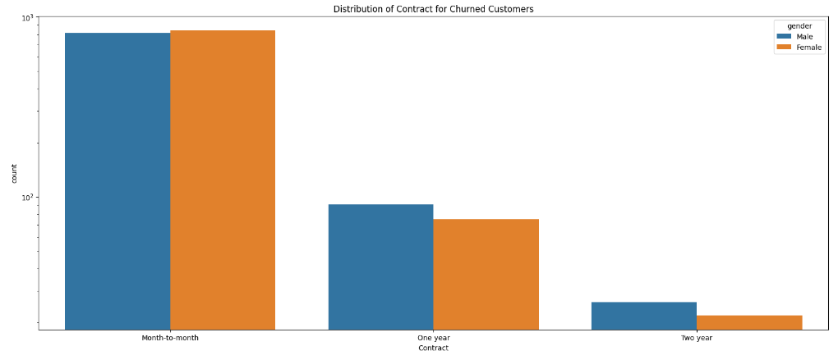

Slide 23
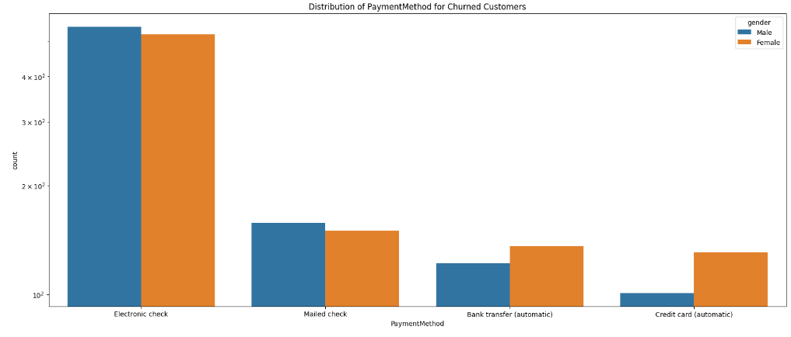

Slide 24
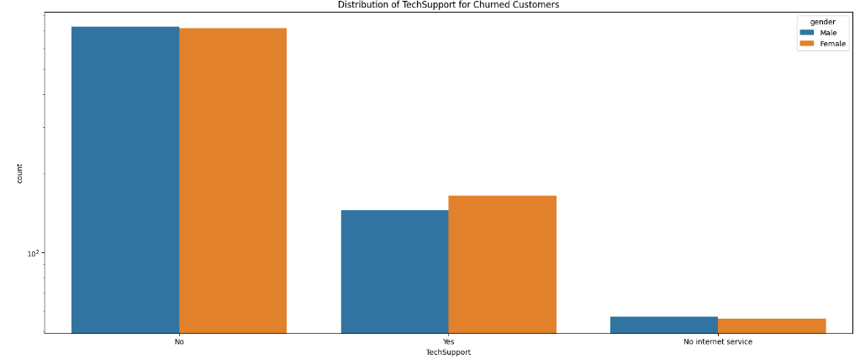

Slide 25
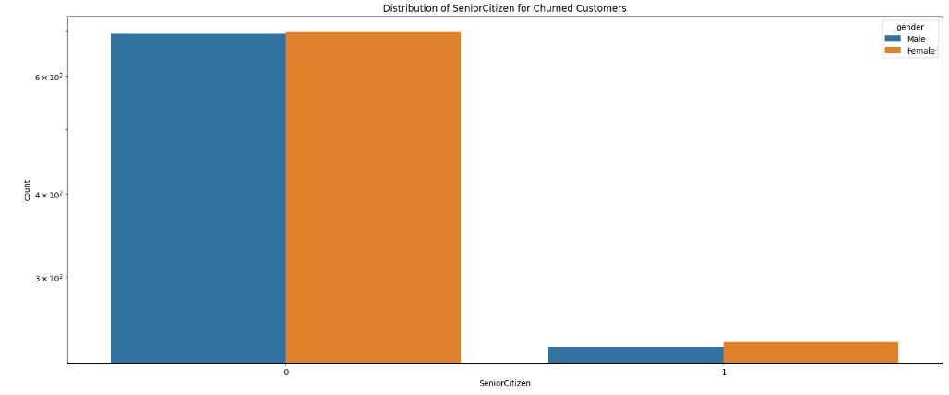

Slide 26
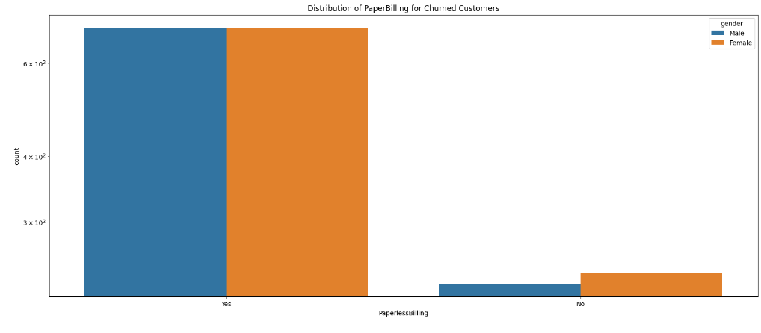

Slide 27
Final Thoughts:
Non-Senior Citizens are more likely to churn.
People with no partners are more likely to churn; furthermore, single women are more likely to do so than single men.
Contract Type - Monthy contracts are more likely to churn becuase of no contract terms, as they are free customers.
Customers who pay via Electronic Check are more likely to churn. Additionally, female customers who pay via Credit Card are also more likely to churn.
Customers with paperless bills have higher churn rates than those with paper bills. Additionally, females with paper bills churn more than males.
MonthlyCharges and TotalCharges are postively correlated.
Churn is high when Monthly Charges are high
Customers who don't have Online Security and Tech Support are high churners.
People who are in the company between 1 to 12 months that means all the new customers are more likely to churn.
People who use internet service via fiber optics are more likely to churn.

